Slide 1
Multiple Processor Systems
Chapter 8
8.1 Multiprocessors
8.2 Multicomputers
8.3 Distributed systems

Slide 2
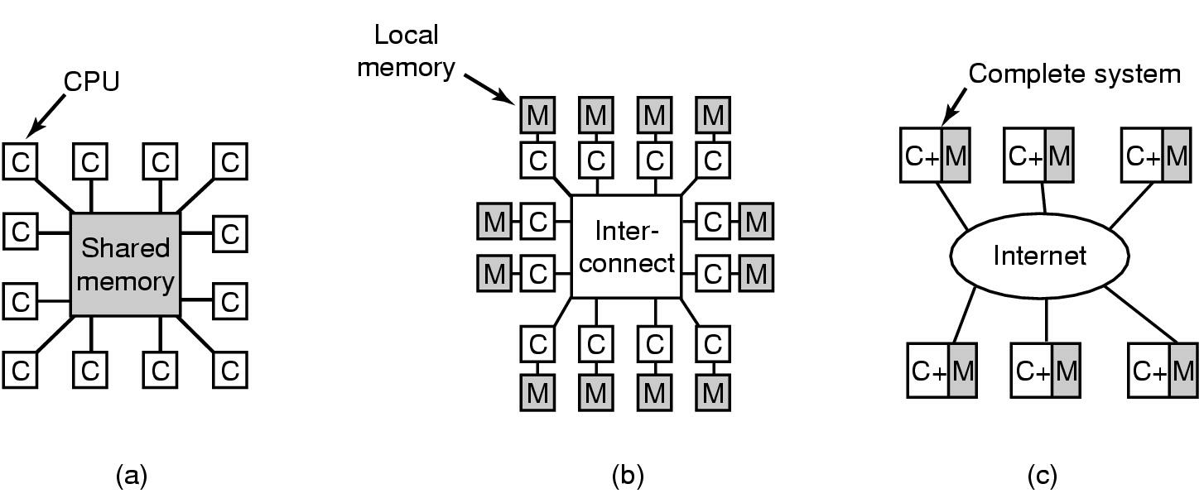
Multiprocessor Systems
Continuous need for faster computers
  shared memory model
  message passing multiprocessor
  wide area distributed system

Slide 3
Multiprocessors
Definition:
A computer system in which two or more CPUs share full access to a common RAM

Slide 4
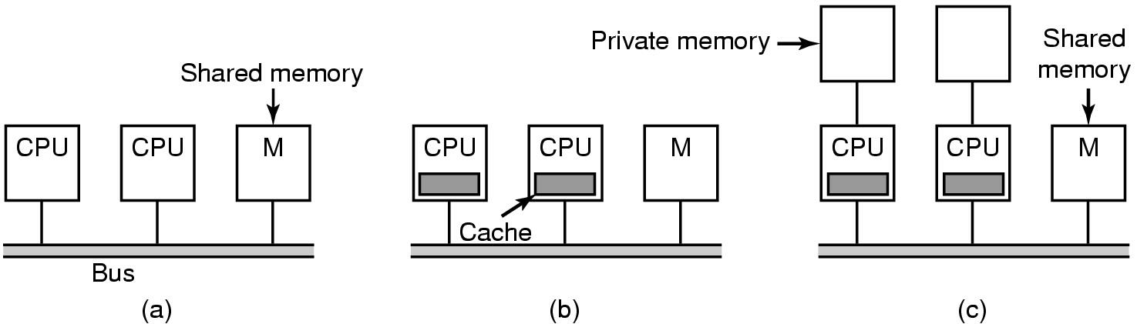
Multiprocessor Hardware (1)
Bus-based multiprocessors

Slide 5
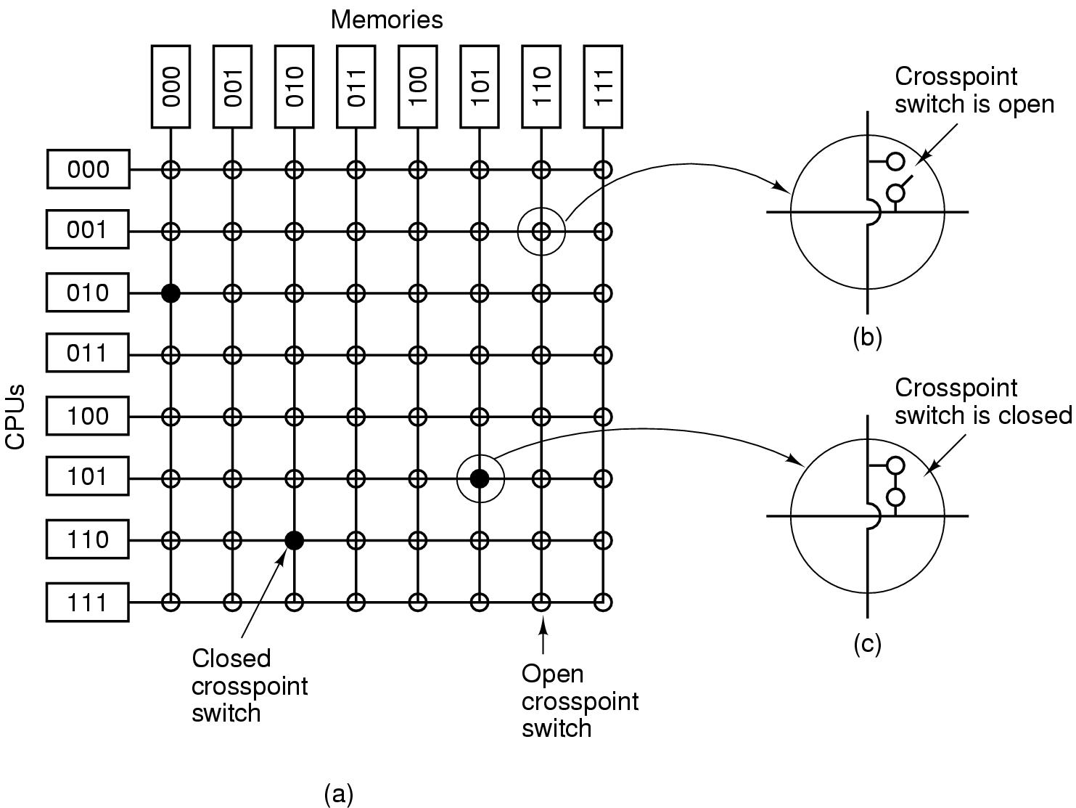
Multiprocessor Hardware (2)
UMA Multiprocessor using a crossbar switch

Slide 6
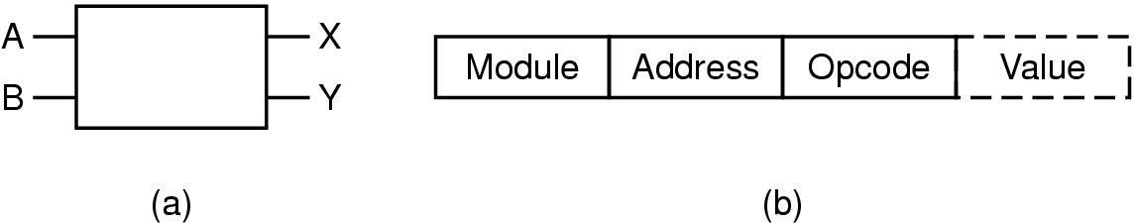
Multiprocessor Hardware (3)
UMA multiprocessors using multistage switching networks can be built from 2x2 switches
(a) 2x2 switch (b) Message format

Slide 7
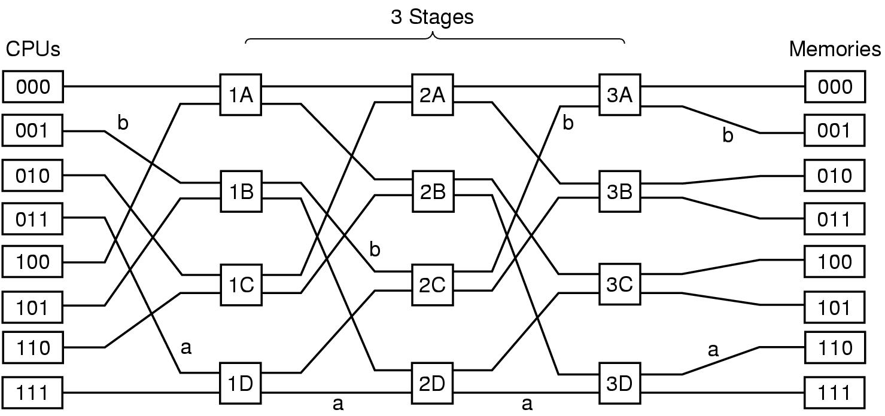
Multiprocessor Hardware (4)
Omega Switching Network

Slide 8
Multiprocessor Hardware (5)
NUMA Multiprocessor Characteristics
Single address space visible to all CPUs
Access to remote memory via commands
  LOAD
  STORE
Access to remote memory slower than to local

Slide 9
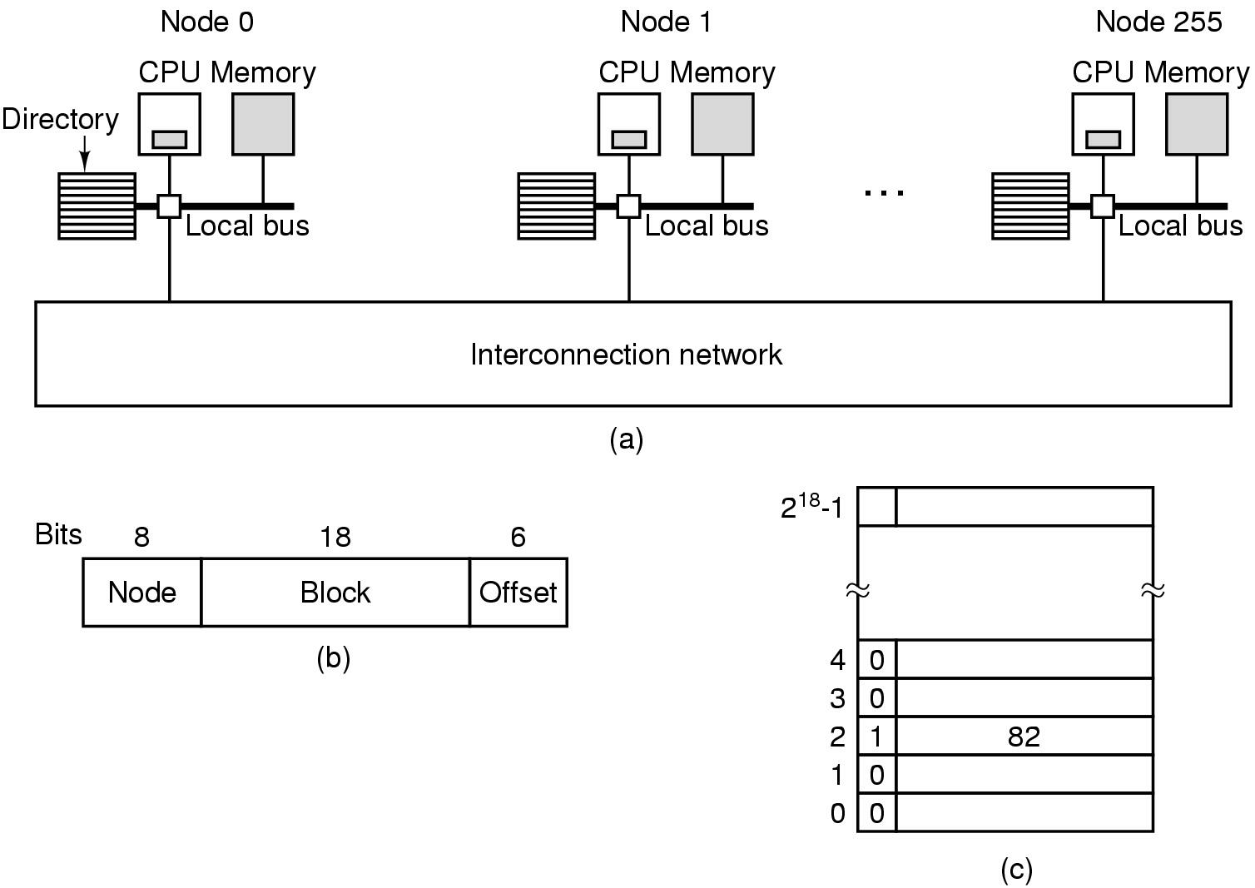
Multiprocessor Hardware (6)
(a) 256-node directory based multiprocessor
(b) Fields of 32-bit memory address
(c) Directory at node 36

Slide 10
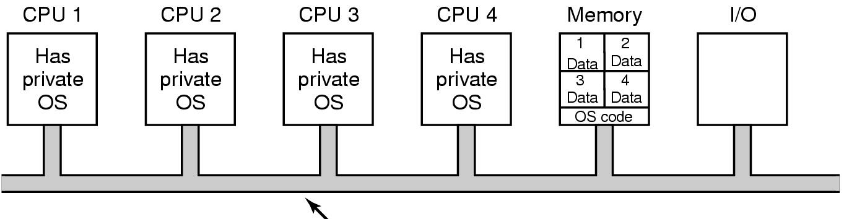
Multiprocessor OS Types (1)
Bus
Each CPU has its own operating system

Slide 11
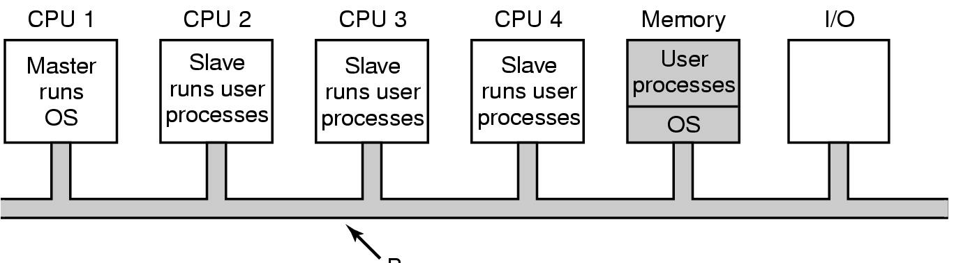
Multiprocessor OS Types (2)
Bus
Master-Slave multiprocessors

Slide 12
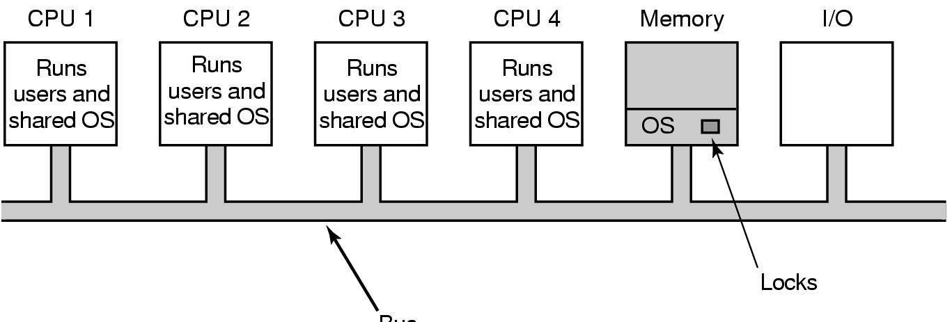
Multiprocessor OS Types (3)
Bus
Symmetric Multiprocessors
  SMP multiprocessor model

Slide 13
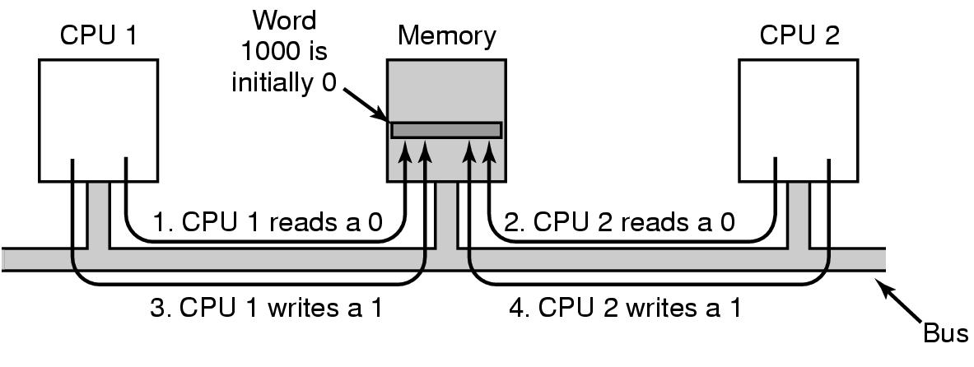
Multiprocessor Synchronization (1)
TSL instruction can fail if bus already locked

Slide 14
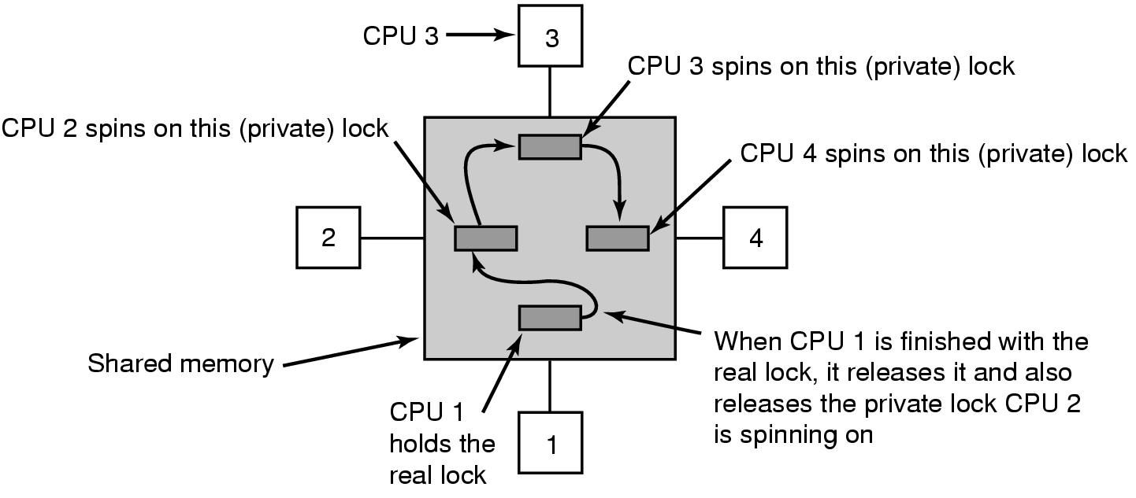
Multiprocessor Synchronization (2)
Multiple locks used to avoid cache thrashing

Slide 15
Multiprocessor Synchronization (3)
Spinning versus Switching
In some cases CPU must wait
  waits to acquire ready list
In other cases a choice exists
  spinning wastes CPU cycles
  switching uses up CPU cycles also
  possible to make separate decision each time locked mutex encountered

Slide 16
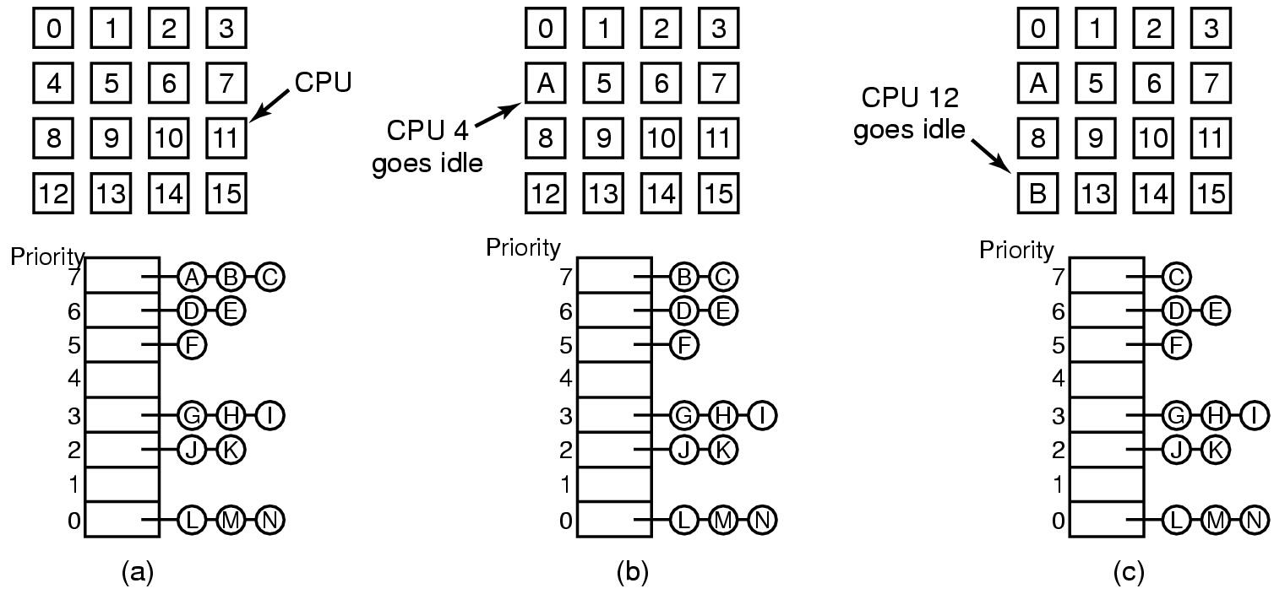
Multiprocessor Scheduling (1)
Timesharing
  note use of single data structure for scheduling

Slide 17
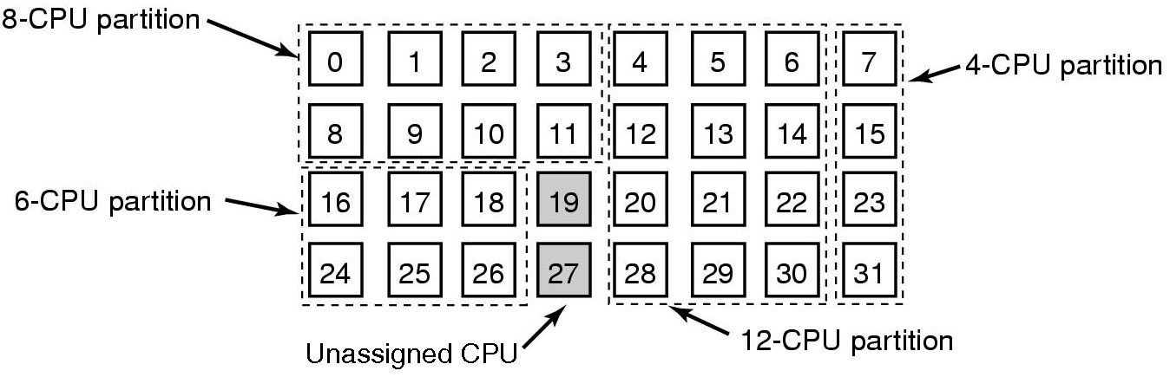
Multiprocessor Scheduling (2)
Space sharing
  multiple threads at same time across multiple CPUs

Slide 18
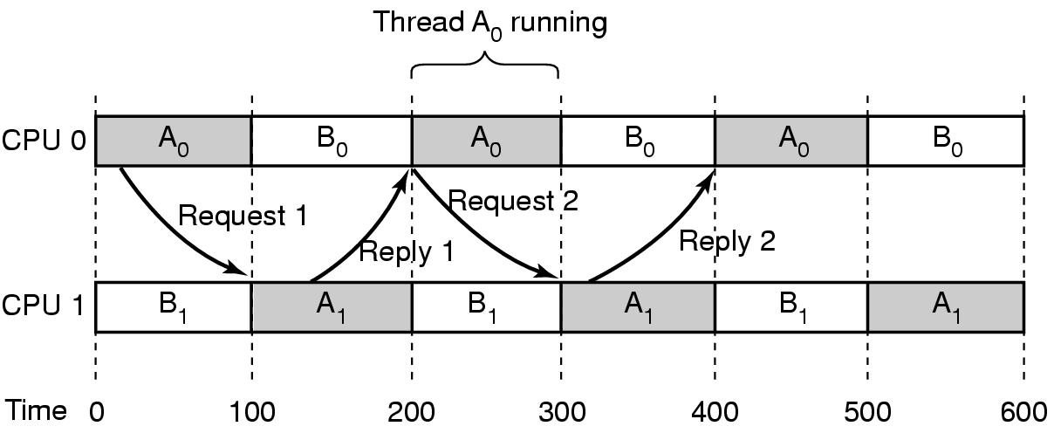
Multiprocessor Scheduling (3)
Problem with communication between two threads
  both belong to process A
  both running out of phase

Slide 19
Multiprocessor Scheduling (4)
Solution: Gang Scheduling
  Groups of related threads scheduled as a unit (a gang)
  All members of gang run simultaneously
    on different timeshared CPUs
  All gang members start and end time slices together

Slide 20
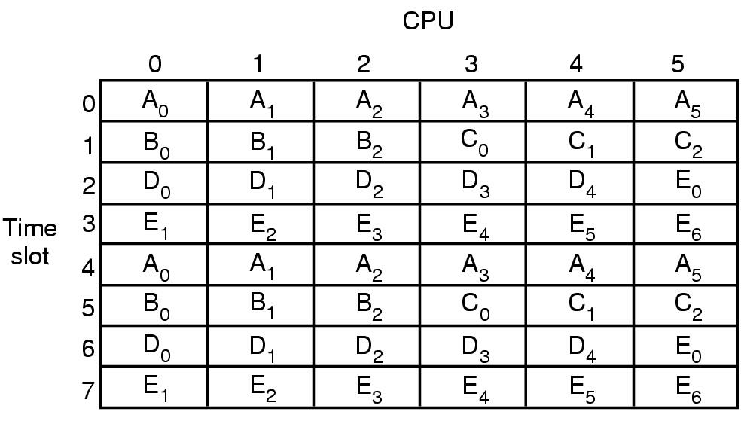
Multiprocessor Scheduling (5)
Gang Scheduling

Slide 21
Multicomputers
Definition:
Tightly-coupled CPUs that do not share memory
Also known as
  cluster computers
  clusters of workstations (COWs)

Slide 22
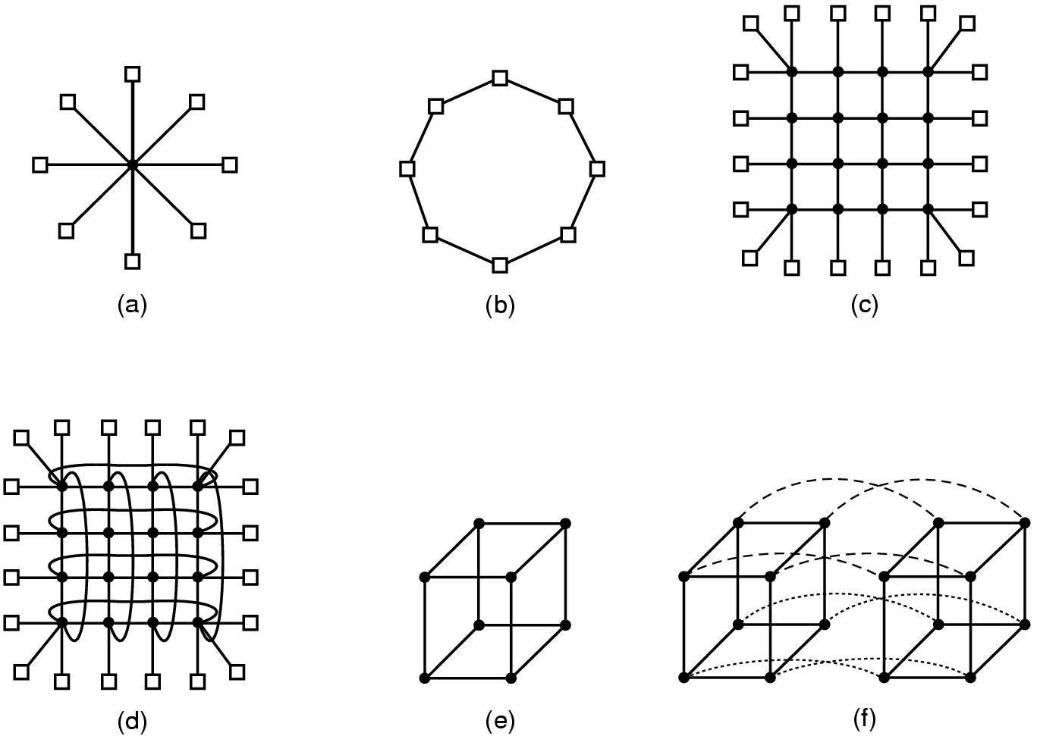
Multicomputer Hardware (1)
Interconnection topologies
  (a) single switch
  (b) ring
  (c) grid
  (d) double torus
  (e) cube
  (f) hypercube

Slide 23
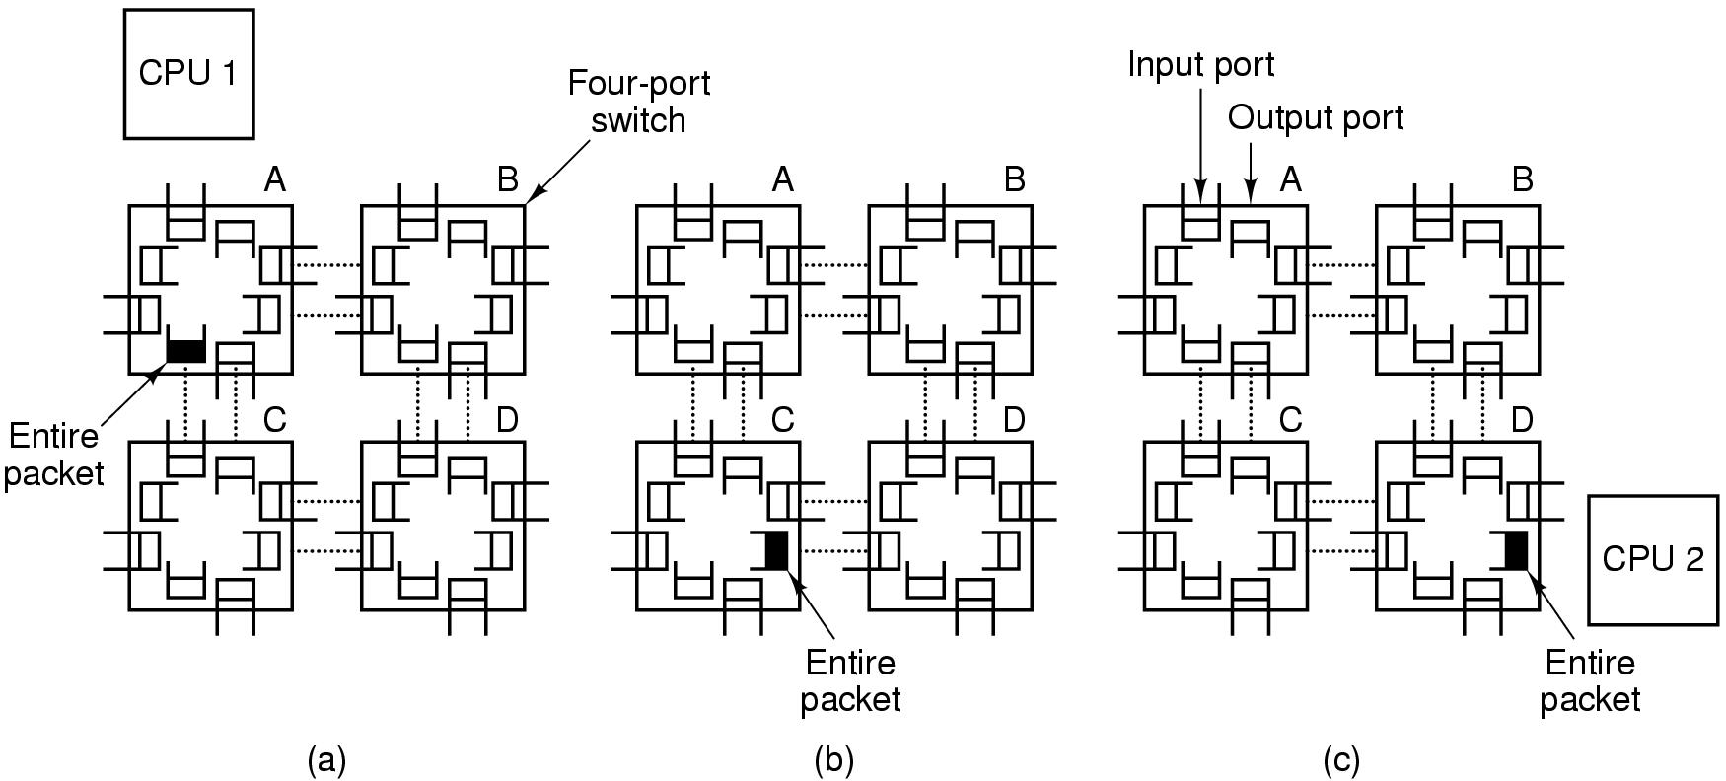
Multicomputer Hardware (2)
Switching scheme
  store-and-forward packet switching

Slide 24
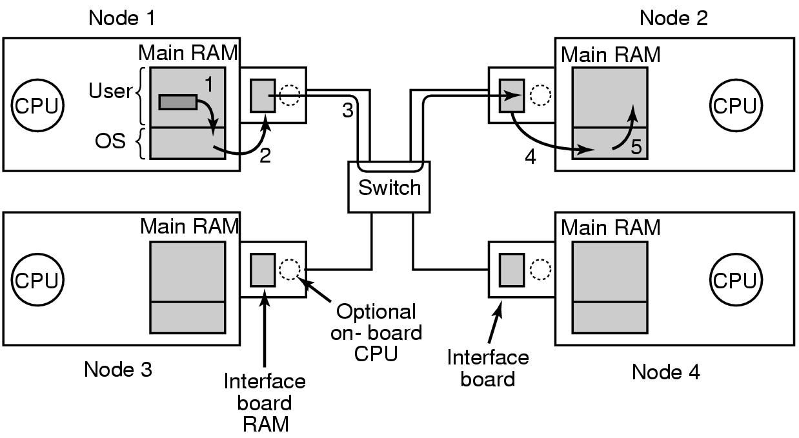
Multicomputer Hardware (3)
Network interface boards in a multicomputer

Slide 25
Low-Level Communication Software (1)
If several processes running on node
  need network access to send packets …
Map interface board to all process that need it
If kernel needs access to network …
Use two network boards
  one to user space, one to kernel

Slide 26
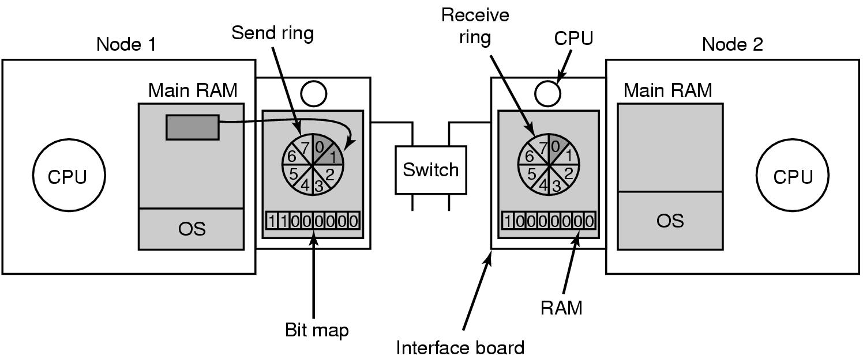
Low-Level Communication Software (2)
Node to Network Interface Communication
Use send & receive rings
coordinates main CPU with on-board CPU

Slide 27
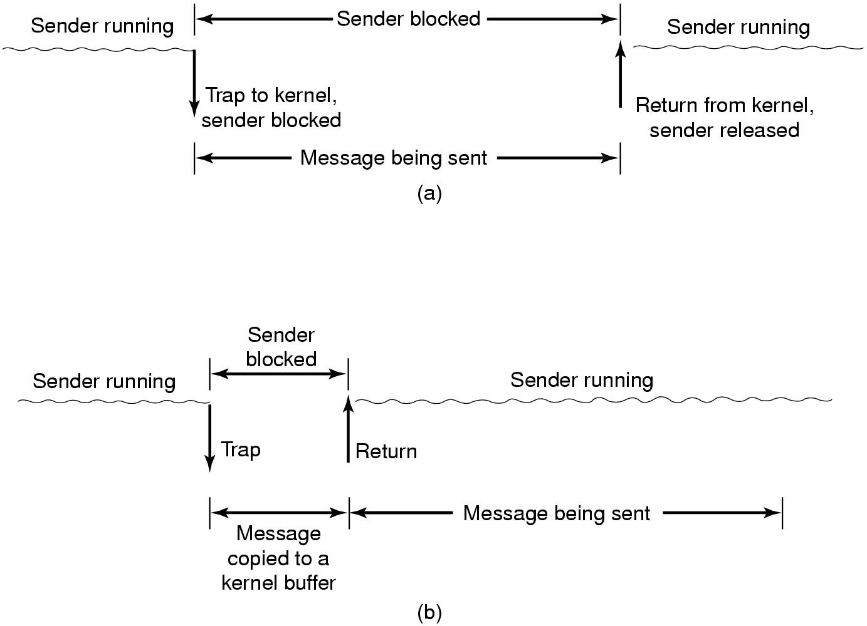
User Level Communication Software
(a) Blocking send call
Minimum services
provided
  send and receive
  commands
These are blocking
(synchronous) calls
(b) Nonblocking send call

Slide 28
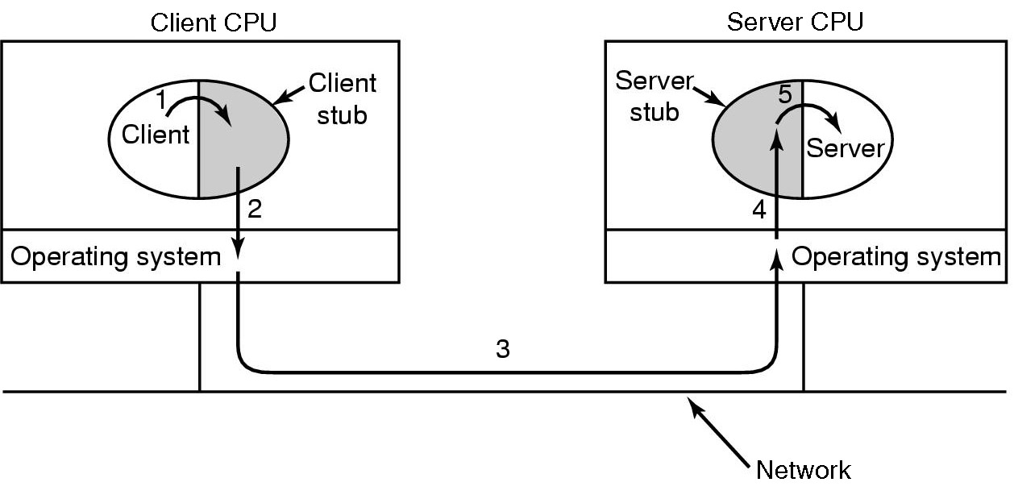
Remote Procedure Call (1)
Steps in making a remote procedure call
  the stubs are shaded gray

Slide 29
Remote Procedure Call (2)
Implementation Issues
Cannot pass pointers
  call by reference becomes copy-restore (but might fail)
Weakly typed languages
  client stub cannot determine size
Not always possible to determine parameter types
Cannot use global variables
  may get moved to remote machine

Slide 30
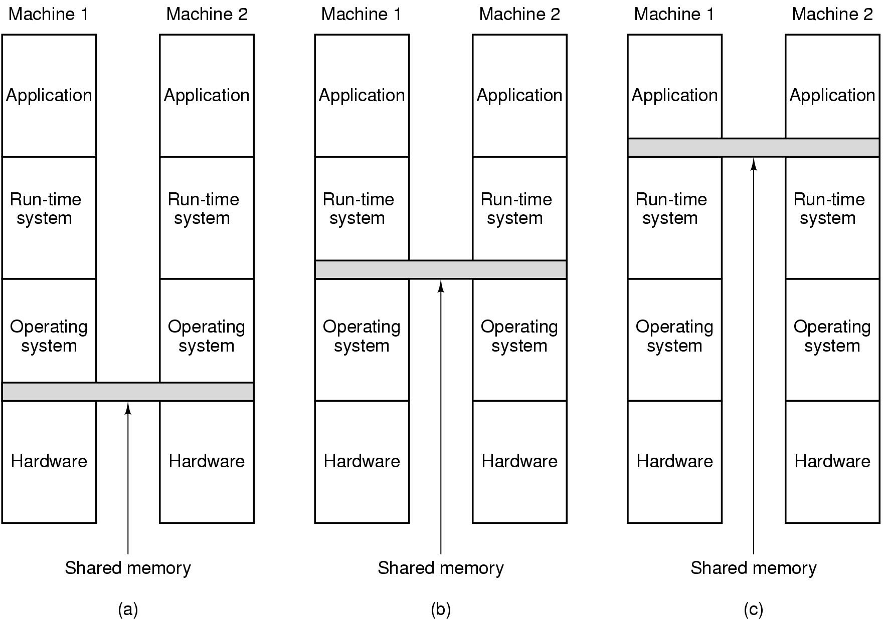
Distributed Shared Memory (1)
Note layers where it can be implemented
  hardware
  operating system
  user-level software

Slide 31
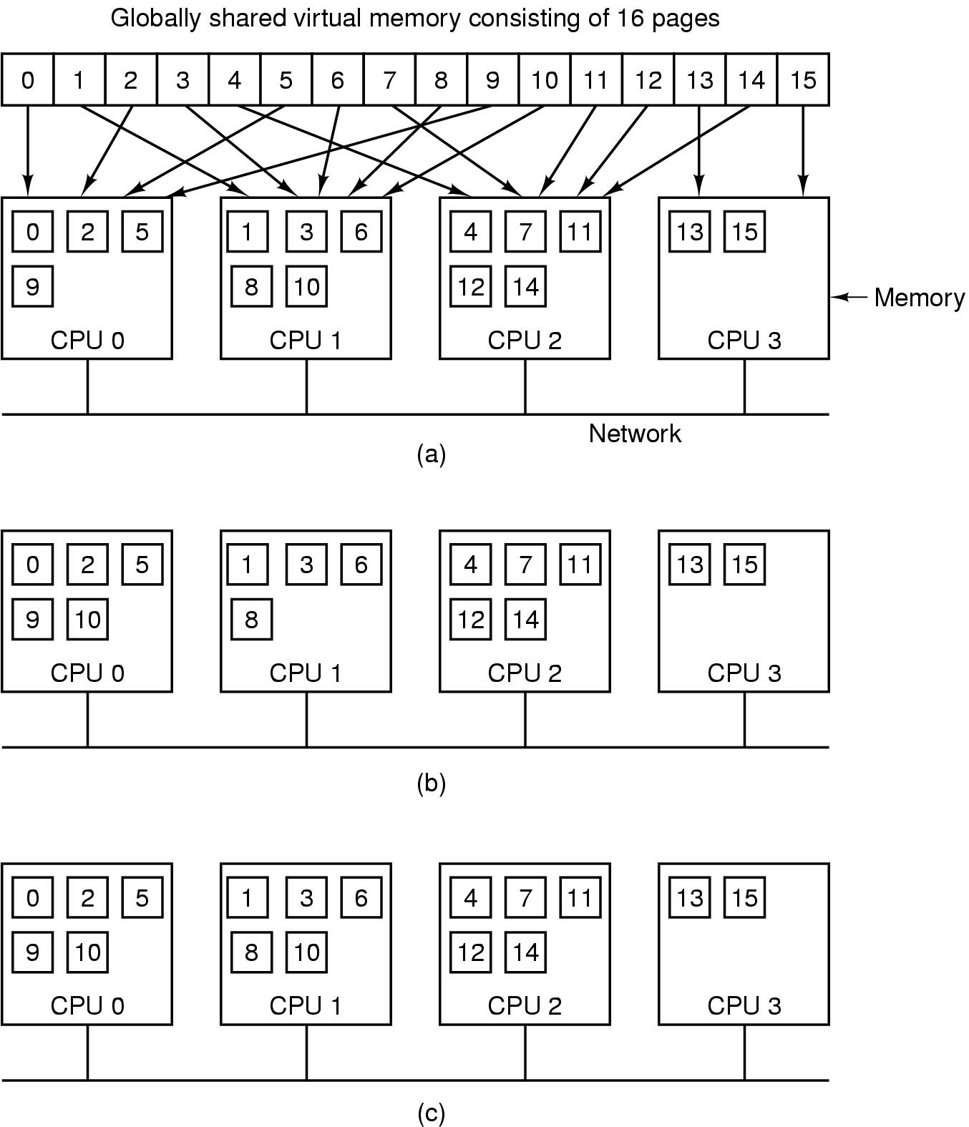
Distributed Shared Memory (2)
Replication
(a) Pages distributed on 4 machines
(b) CPU 0 reads page 10
(c) CPU 1 reads page 10

Slide 32
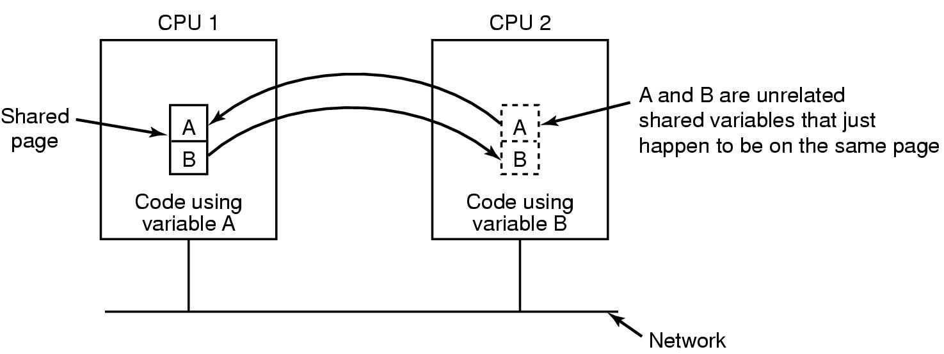
Distributed Shared Memory (3)
False Sharing
Must also achieve sequential consistency

Slide 33
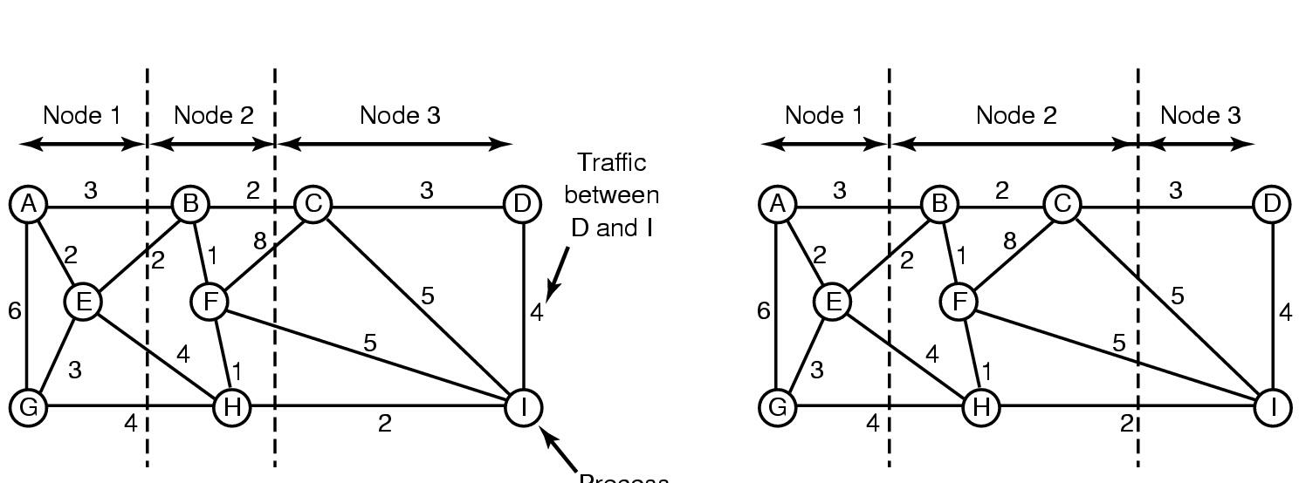
Multicomputer Scheduling
Load Balancing (1)
Process
Graph-theoretic deterministic algorithm

Slide 34
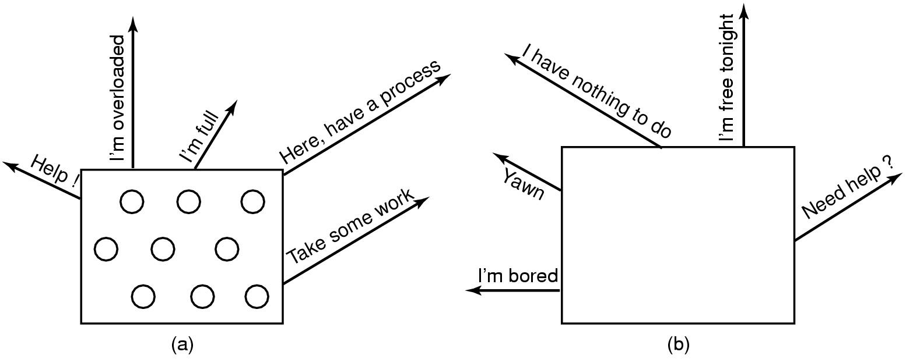
Load Balancing (2)
Sender-initiated distributed heuristic algorithm
  overloaded sender

Slide 35
Load Balancing (3)
Receiver-initiated distributed heuristic algorithm
  under loaded receiver

Slide 36
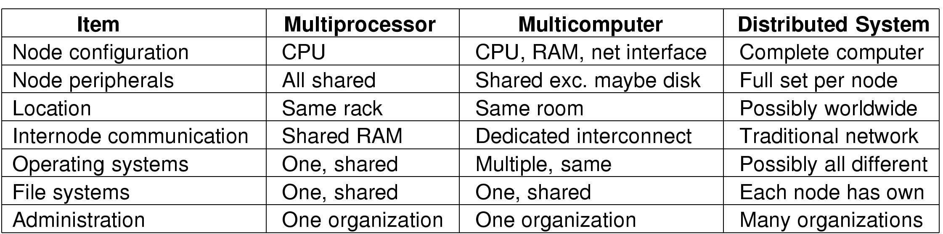
Distributed Systems (1)
Comparison of three kinds of multiple CPU systems

Slide 37
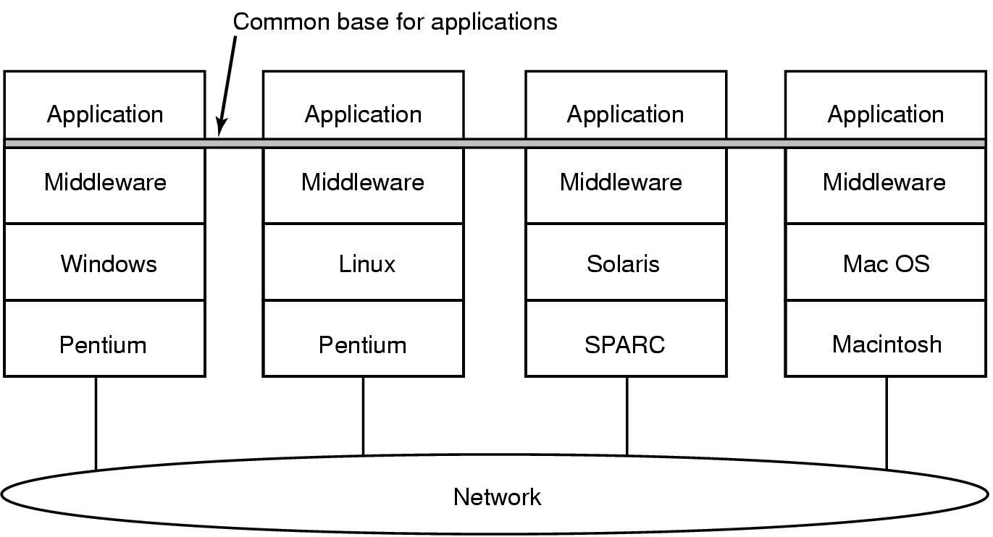
Distributed Systems (2)
Achieving uniformity with middleware

Slide 38
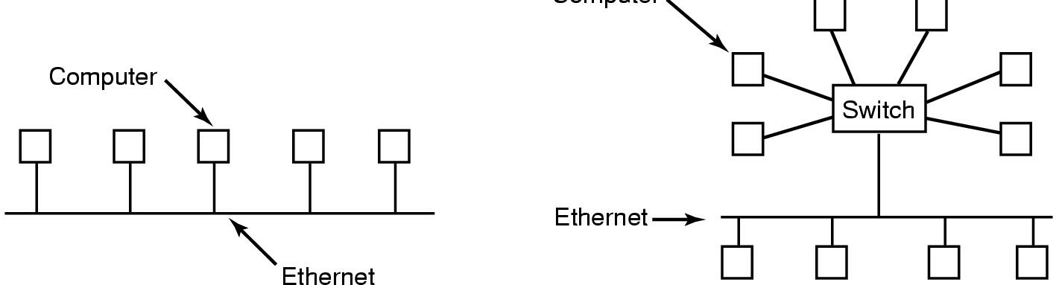
Network Hardware (1)
Computer
(a)
(b)
Ethernet
  (a) classic Ethernet
  (b) switched Ethernet

Slide 39
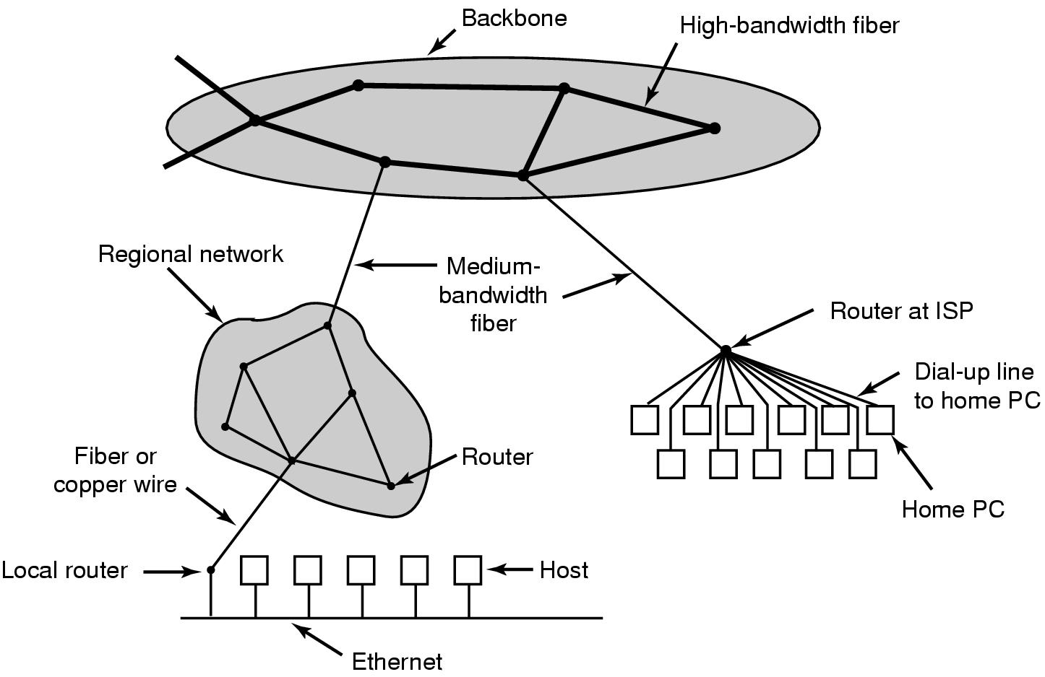
Network Hardware (2)
The Internet

Slide 40
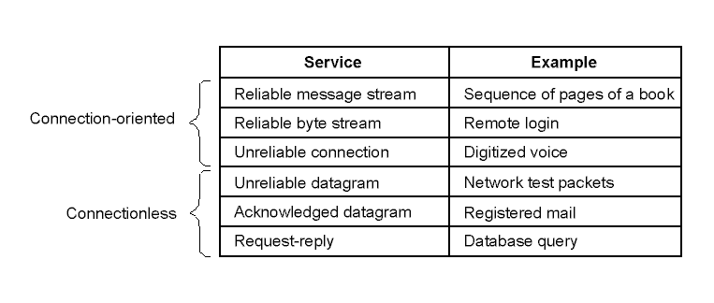
Network Services and Protocols (1)
Network Services

Slide 41
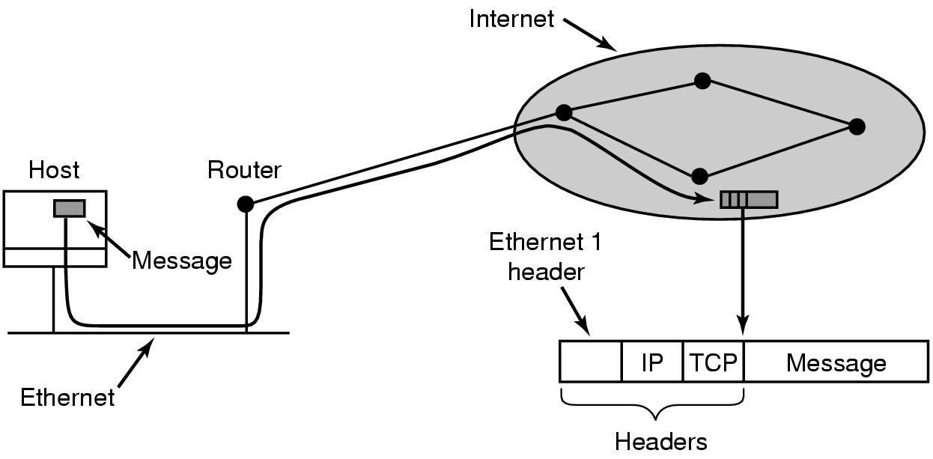
Network Services and Protocols (2)
Internet Protocol
Transmission Control Protocol
Interaction of protocols

Slide 42
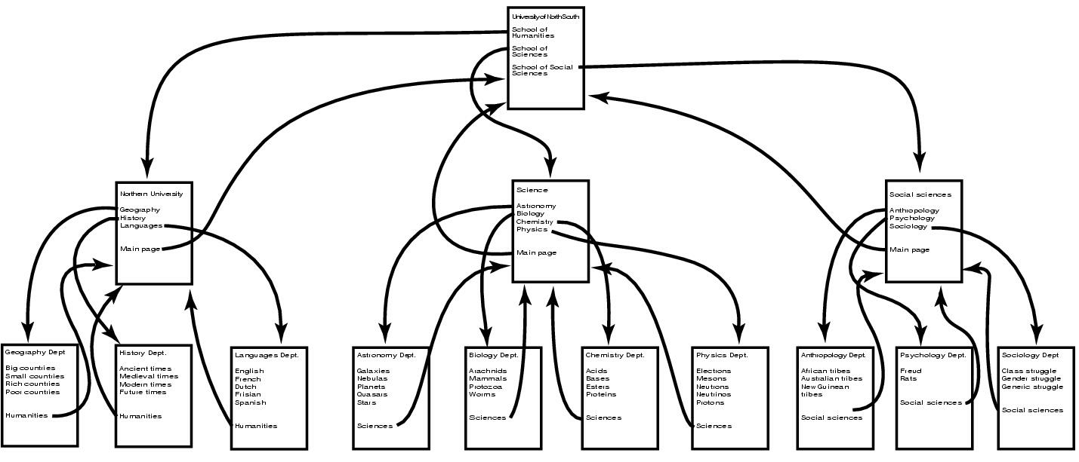
Document-Based Middleware (1)
The Web
  a big directed graph of documents

Slide 43
Document-Based Middleware (2)
How the browser gets a page
Asks DNS for IP address
DNS replies with IP address
Browser makes connection
Sends request for specified page
Server sends file
TCP connection released
Browser displays text
Browser fetches, displays images

Slide 44
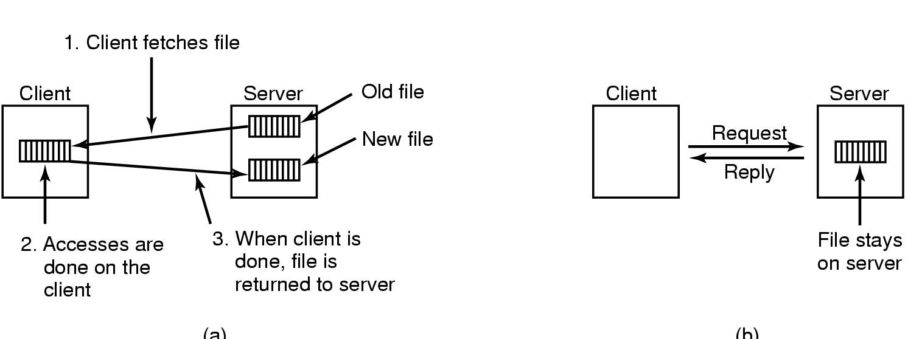
File System-Based Middleware (1)
(b)
(a)
Transfer Models
  (a) upload/download model
  (b) remote access model

Slide 45
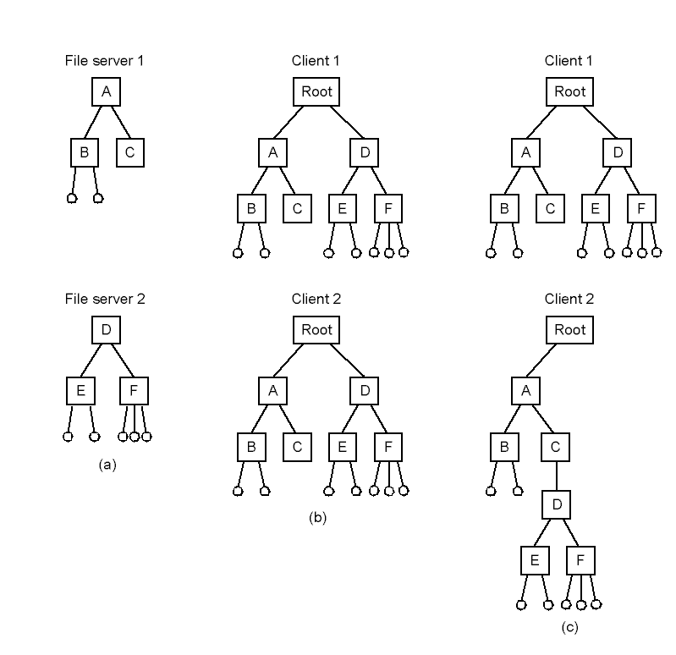
File System-Based Middleware (2)
Naming Transparency
(b) Clients have same view of file system
(c) Alternatively, clients with different view

Slide 46
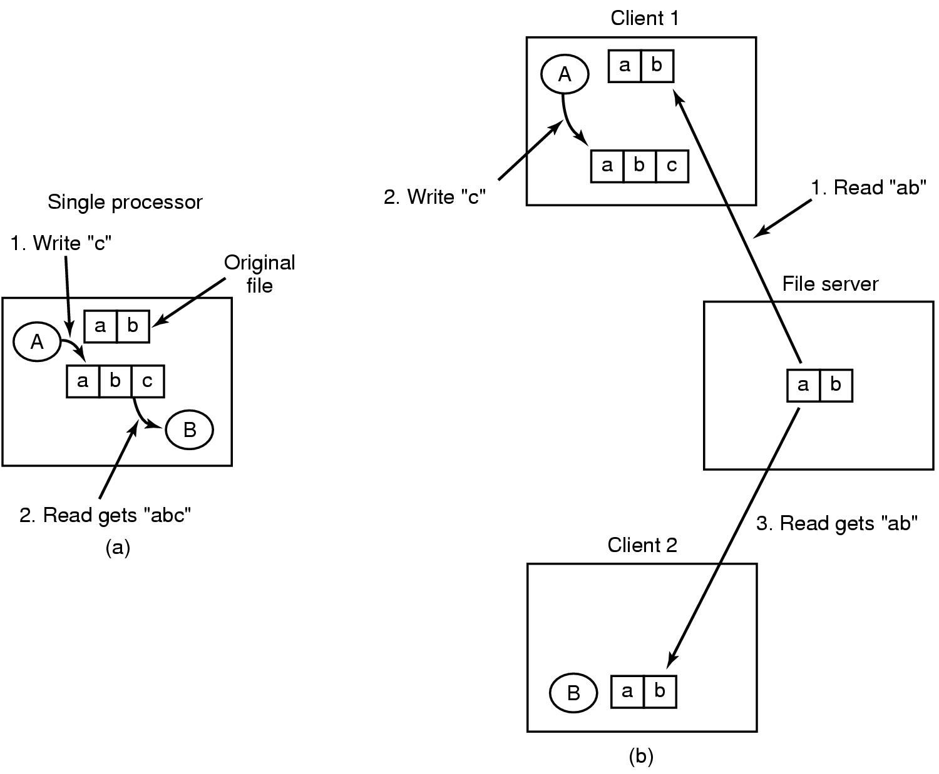
File System-Based Middleware (3)
Semantics of File sharing
  (a) single processor gives sequential consistency
  (b) distributed system may return obsolete value

Slide 47
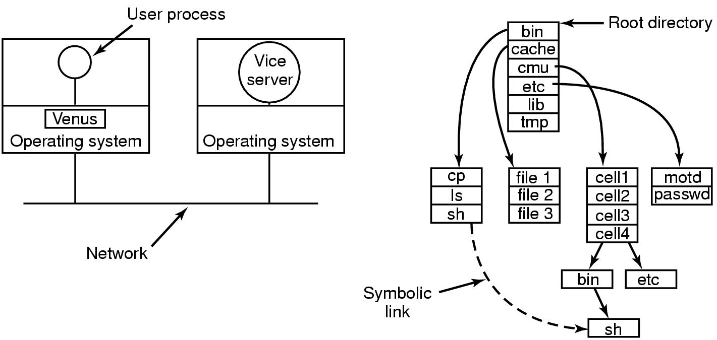
File System-Based Middleware (4)
  Client's view
AFS – Andrew File System
  workstations grouped into cells
  note position of venus and vice

Slide 48
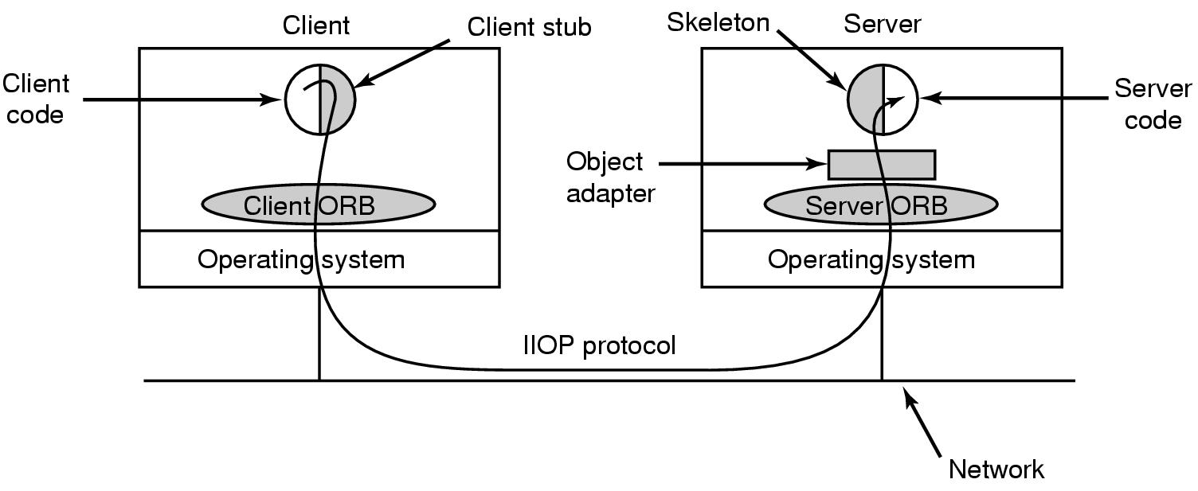
Shared Object-Based Middleware (1)
Main elements of CORBA based system
  Common Object Request Broker Architecture

Slide 49
Shared Object-Based Middleware (2)
Scaling to large systems
  replicated objects
  flexibility
Globe
  designed to scale to a billion users
  a trillion objects around the world

Slide 50
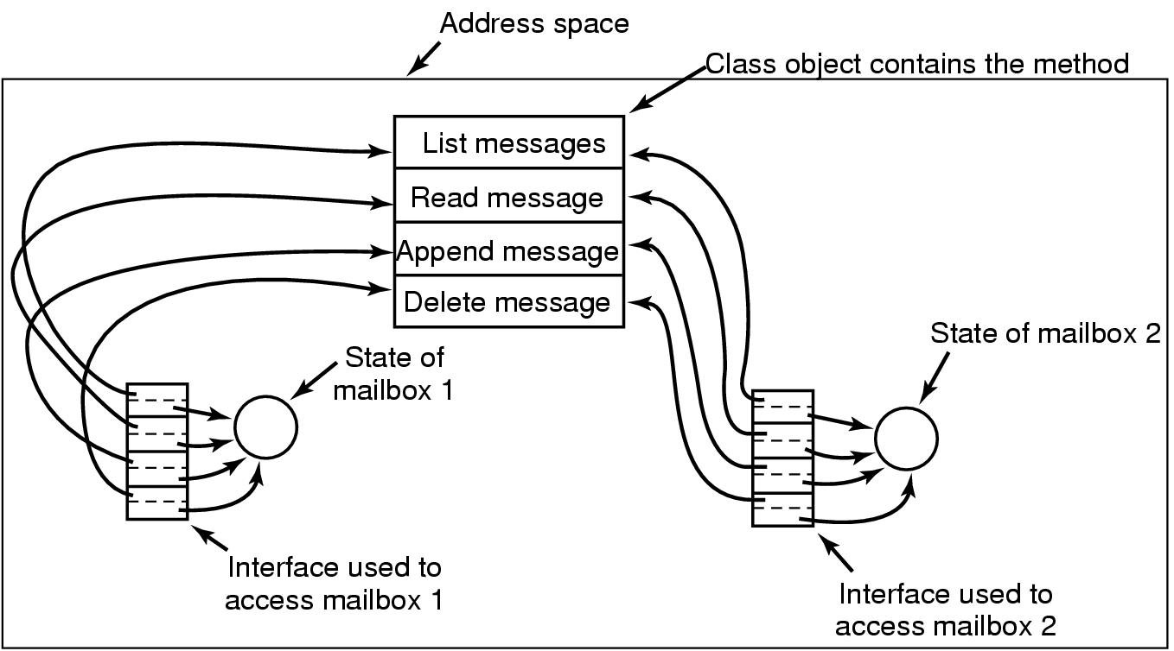
Shared Object-Based Middleware (3)
Globe structured object

Slide 51
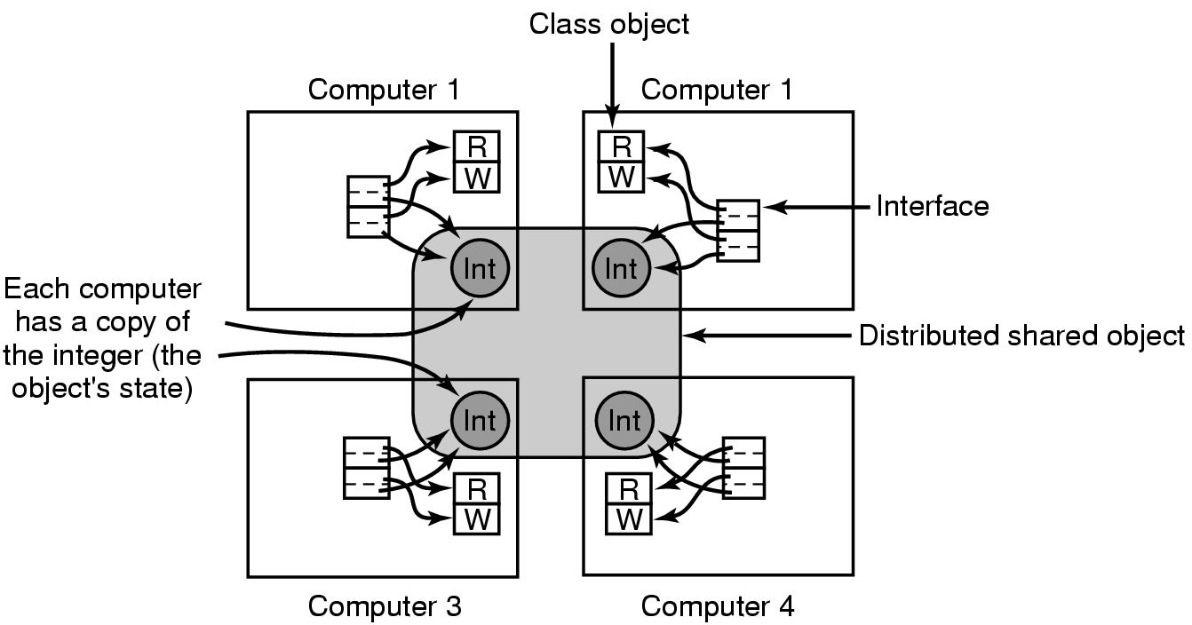
Shared Object-Based Middleware (4)
A distributed shared object in Globe
  can have its state copied on multiple computers at once

Slide 52
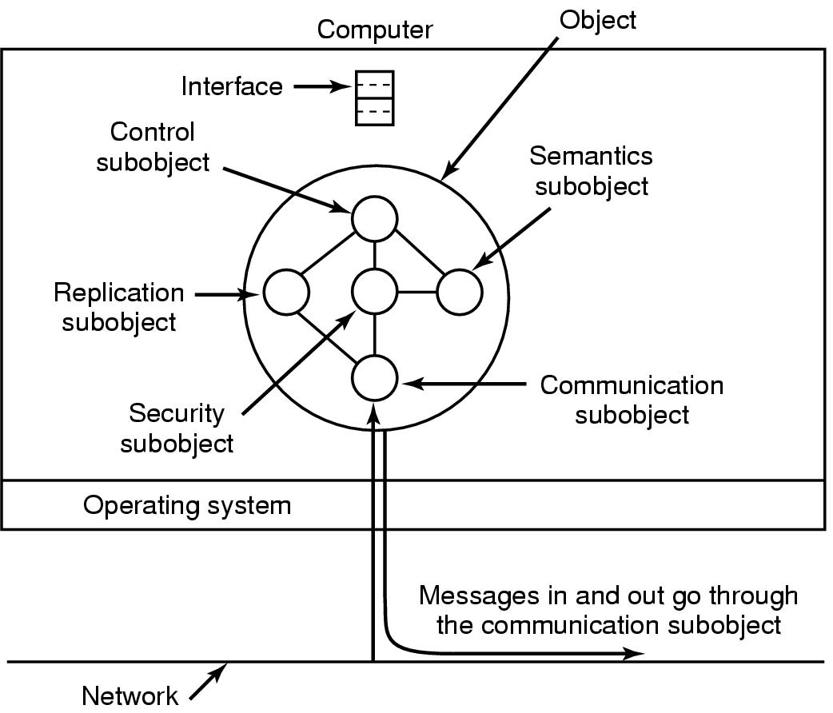
Shared Object-Based Middleware (5)
Internal structure of a Globe object

Slide 53
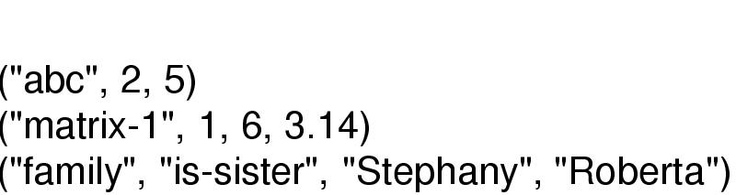
Coordination-Based Middleware (1)
Linda
  independent processes
  communicate via abstract tuple space
Tuple
  like a structure in C, record in Pascal
Operations: out, in, read, eval

Slide 54
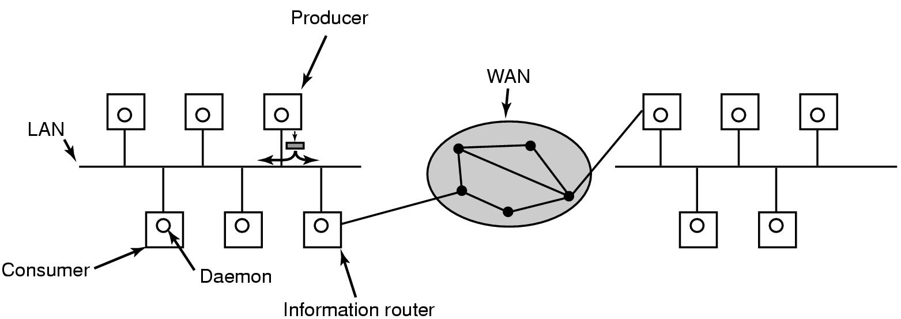
Coordination-Based Middleware (2)
Publish-Subscribe architecture

Slide 55
Coordination-Based Middleware (3)
Jini - based on Linda model
  devices plugged into a network
  offer, use services
Jini Methods
  read
  write
  take
  notify

